Slide 1

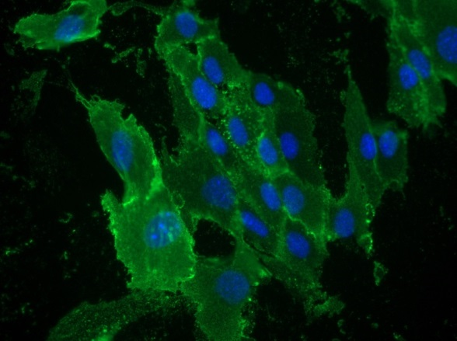
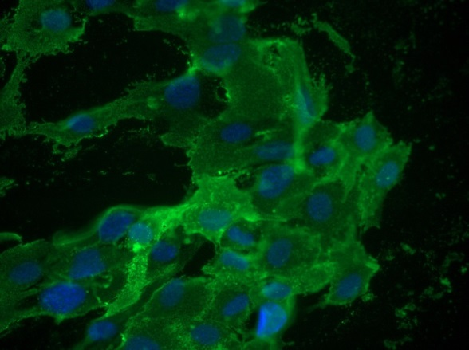
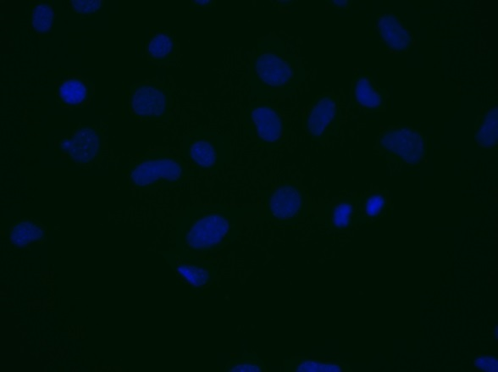
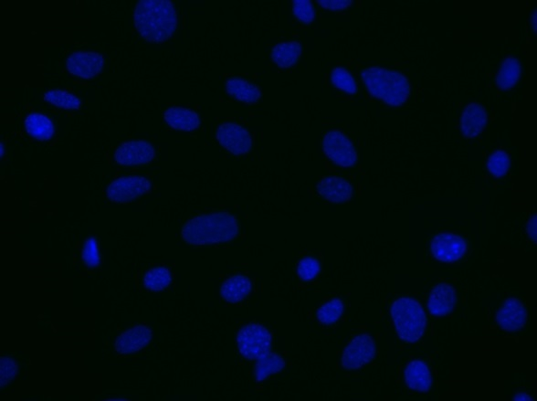
ReliaTech GmbH
Rat anti-mouse CD105 #MJ7/18
rat anti-mouse CD105
rat anti-mouse CD105
Control (goat anti-rat IgG ALEXA Flour 488; 1:400)
Immunofluorescence staining of CD105 in mouse primary endothelial cells (SnoMec) with monoclonal rat anti-mouse CD105 #MJ7/18 [Cat# 103-M60] (upper panel). Control with goat anti-rat ALEXA Flour 488 [Dianova] (lower panel).
[IF_mEC1407-01; 103-M60 (5µg/ml) 400X]
http://www.reliatech.de / info@reliatech.de

